Slide 2
Company Overview
Cycle Services in the Areas of Enterprise Web, Mobility and Cloud Services
Leading Information Technology (IT) Service Company -
Servicing Clients in North America, UK, Europe, Middle East, Singapore and Australia
Development center in Bangalore, India
Provides IT Services and specific solutions to Customers in Various Domains

Slide 3
Company Overview
100+
100+

Slide 4
Why Fortunesoft?
Industry experience of more than 9+ years
Specialization in custom design & development
Innovative Team Members with Web 2.0 Expertise
Quality driven delivery service model
Strong Technology Expertise
Save your project cost up to 40%
Full-cycle services in software development
Global performance based project management
Notes:
Domain Expertise
Proven Track record in timely delivery of Small, medium and Large Scale Projects
Implementing Cutting Edge Technology & Business Solutions
Ability to work round the clock depending on the client geography
Innovative Team Members with Web 2.0 Expertise
Quality Driven Service Delivery Model
Operational Efficiency & Flexibility
Global Exposure and Diverse Expertise

Slide 5
Horizontal Focus

Slide 6
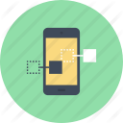
Enterprise Web Portal Design & Development
Web Applications Design & Development
Mobile Applications & Mobile Website Development
E-commerce Application Design & Development
IBE Development and GDS Integration Service
Our Service Offerings
Application Migration & Porting
Digital Marketing Solutions
Application Support and Maintenance
Application Reengineering & Enhancement
Application Audit & Testing

Slide 7
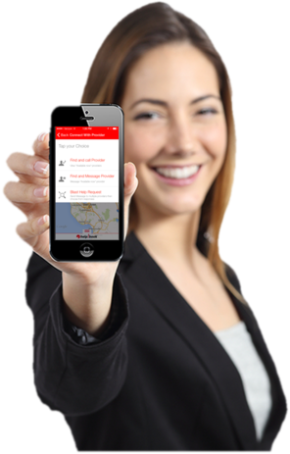
Take a look at Some of our work
Cloud
20+ Projects
Travel
20+ Projects
E-Commerce
20+ Projects
100 + Projects
Mobile
20+ Projects
Web
20+ Projects

Slide 8
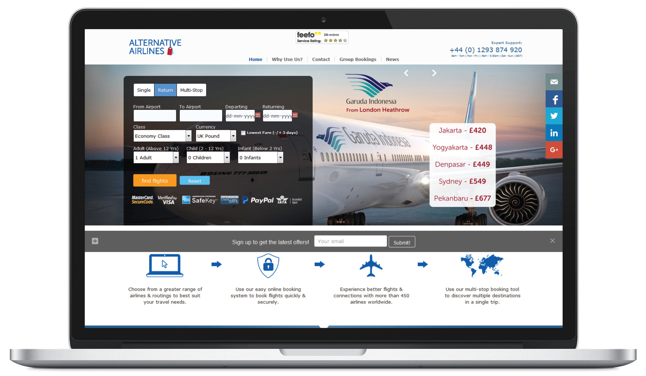
Joomla

Slide 9
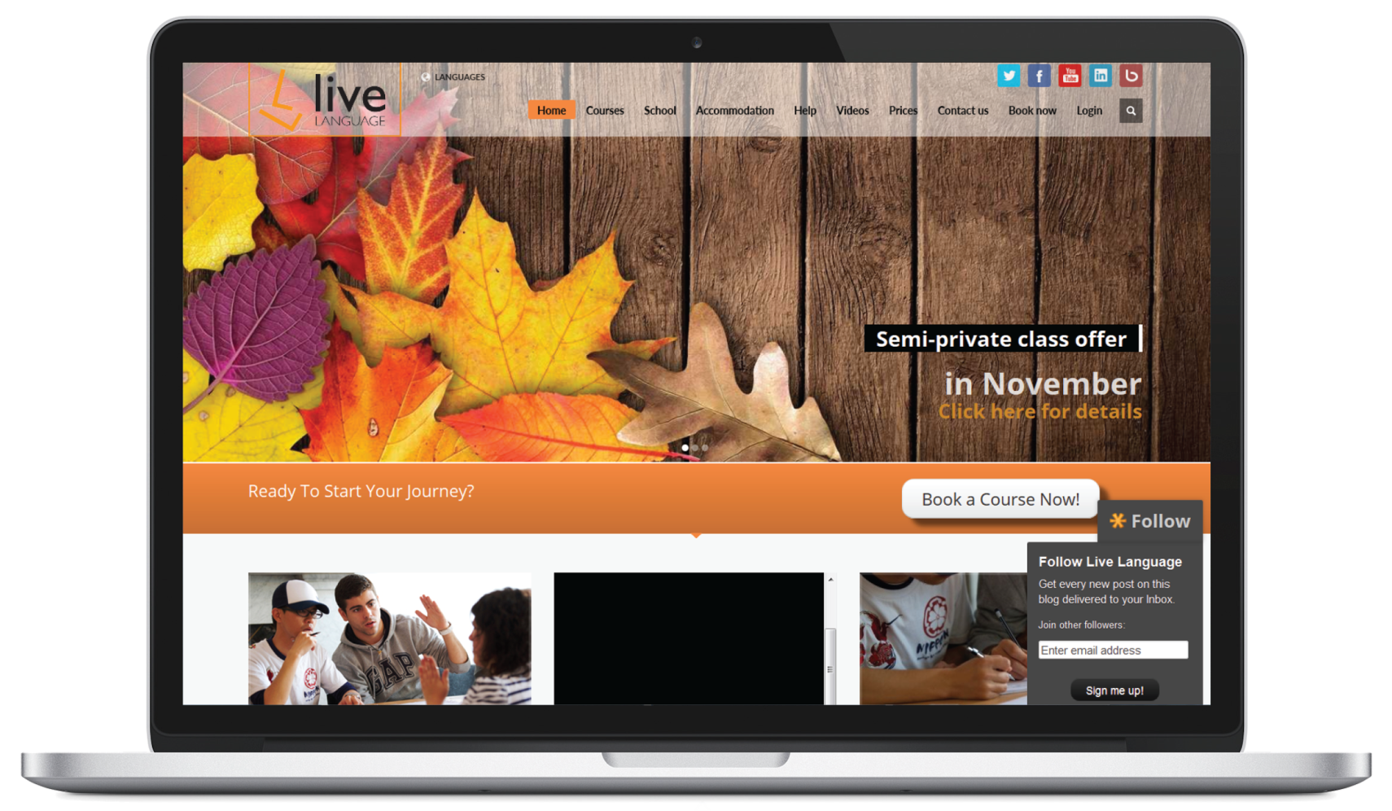
Wordpress

Slide 10
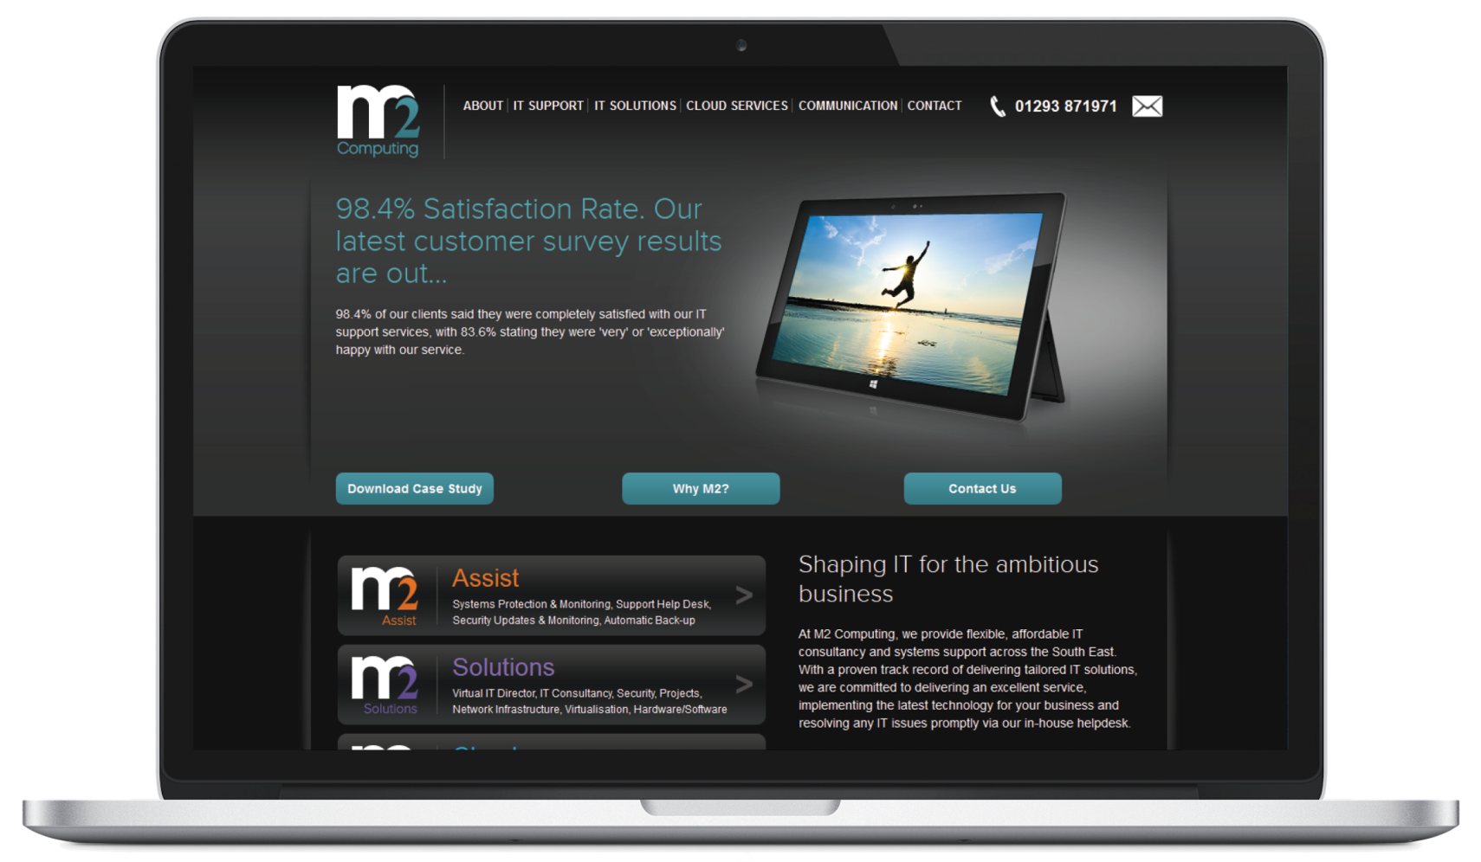
Drupal

Slide 11
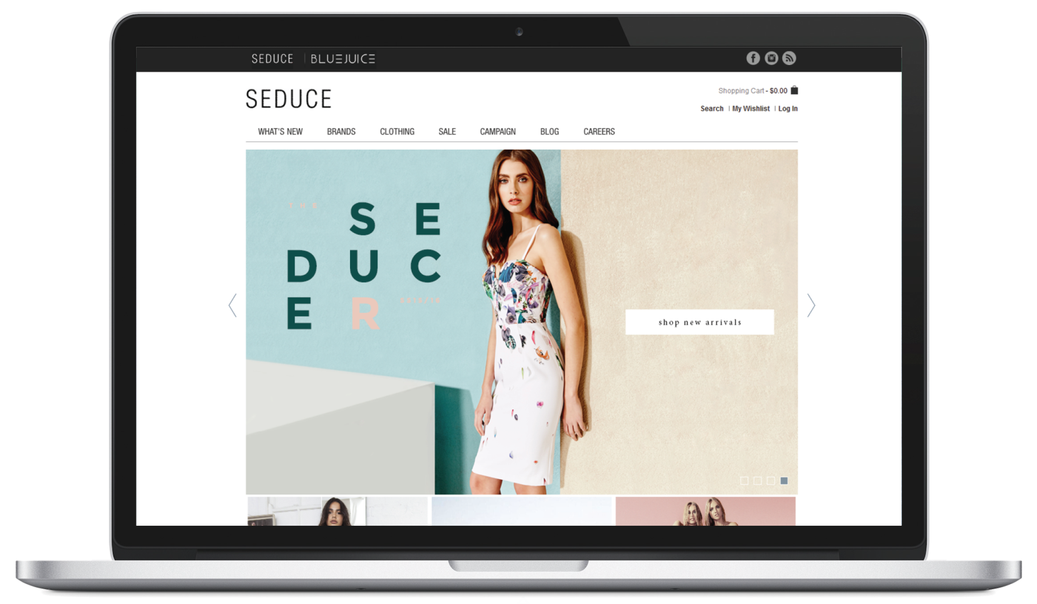
Magento

Slide 12
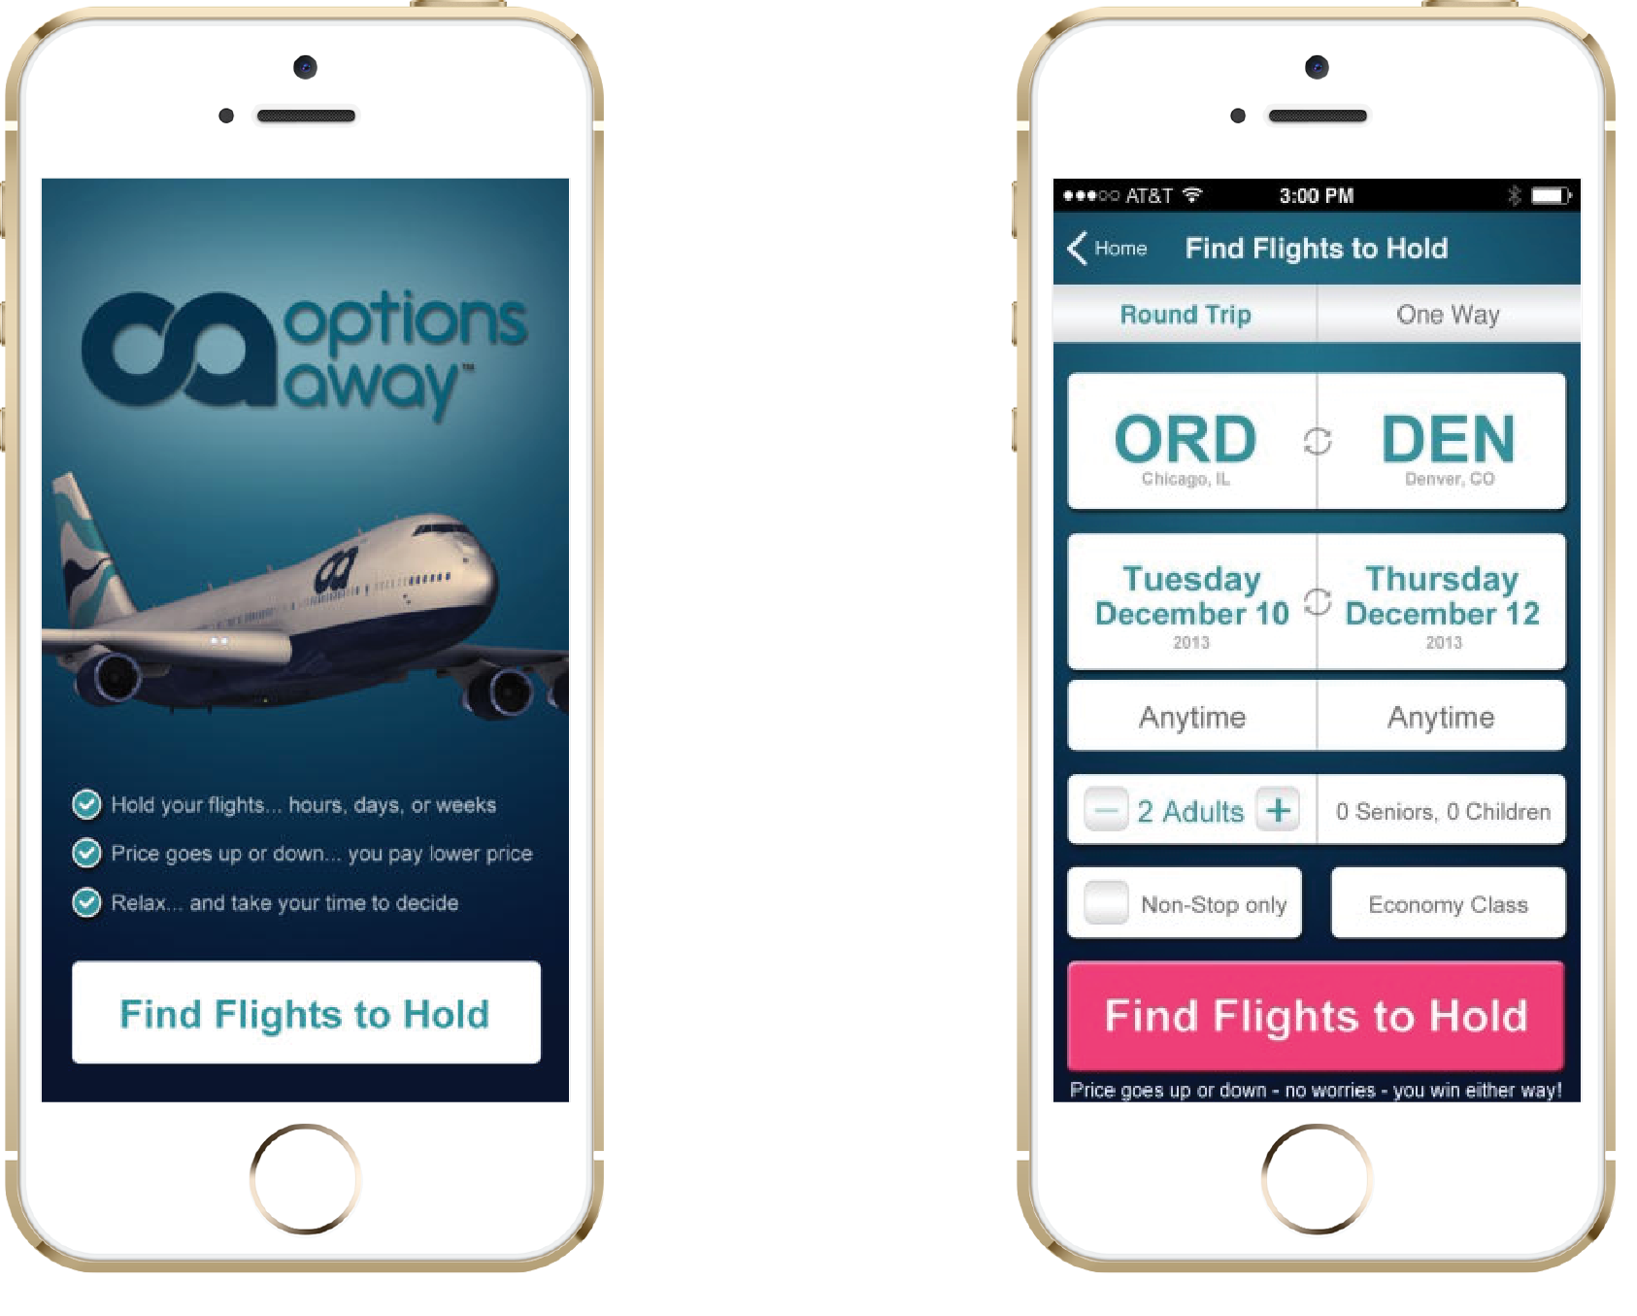
iOS

Slide 13
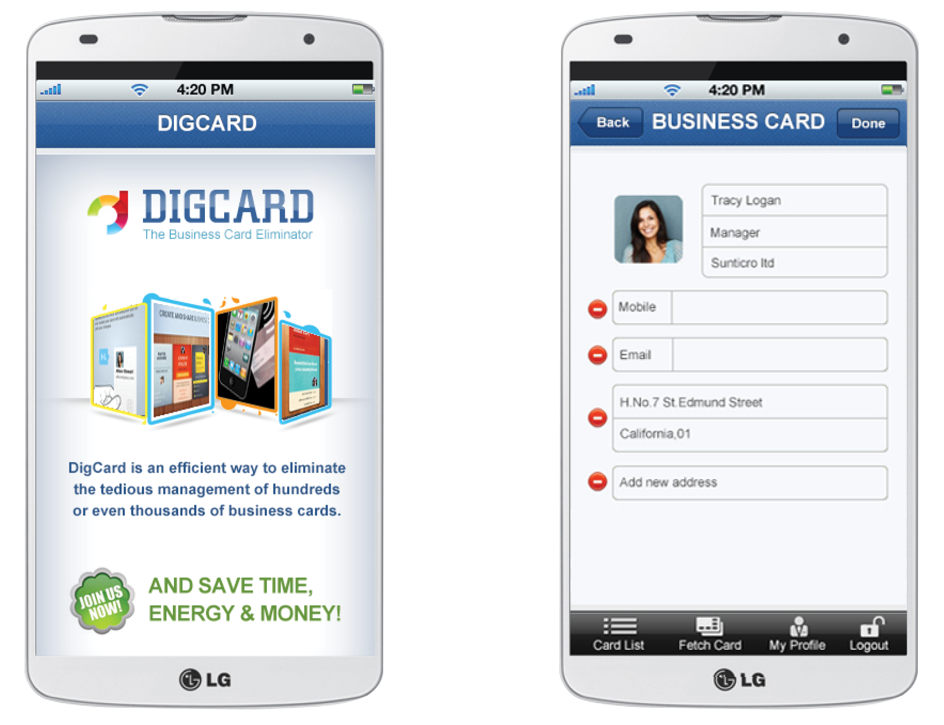
Android

Slide 14
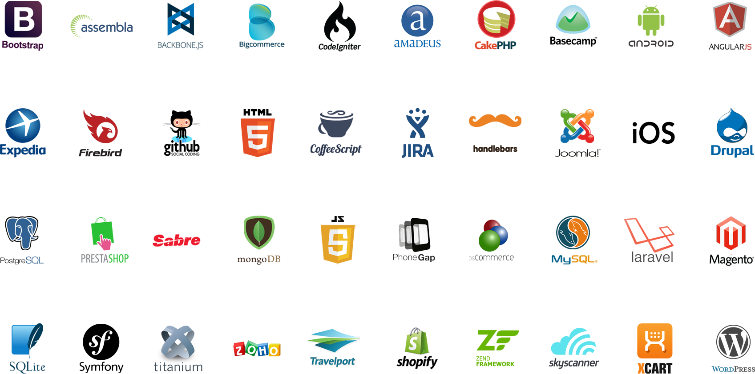
Tools And Internal Skill Sets

Slide 15
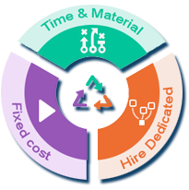
Engagement Models
Time and Material Model
Dedicated resource/ ODC model
Fixed scope/Fixed bid Model
Staff Augmentation
Contractual Staffing
Permanent Staffing
One Time Hire
Contract to Hire

Slide 16
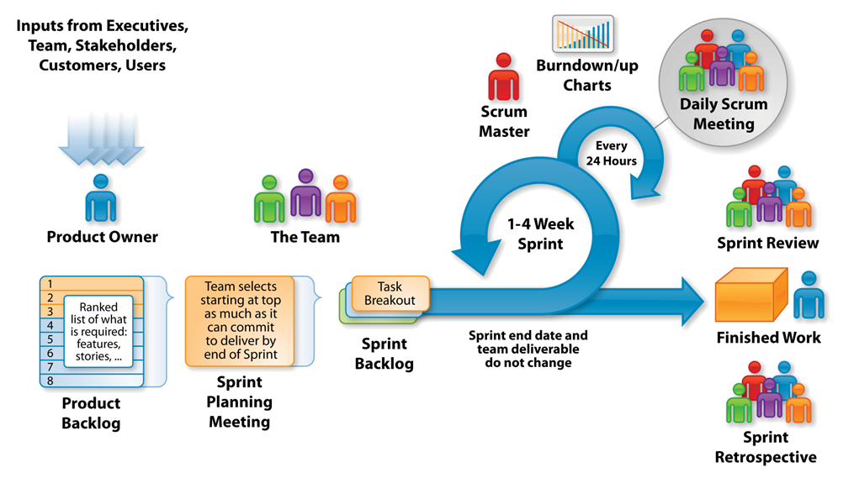
Project Execution: The Agile - Scrum Framework

Slide 17
Value Add/Differentiator
ODC - A dedicated resource model with a flexibility to ramp up and ramp down the team as per client’s needs
A stand-alone resource readily available with KT done on a regular basis
Proof of concept – A way to gauge our competency in terms engagement and excellence
Go Agile – Transparent project execution method, giving the client a visibility on the ongoing projects
Flexibility of engagement models – Onsite, offshore, Dual shore
Availability of technical resource onsite on need basis
Competitive pricing and discounts

Slide 18
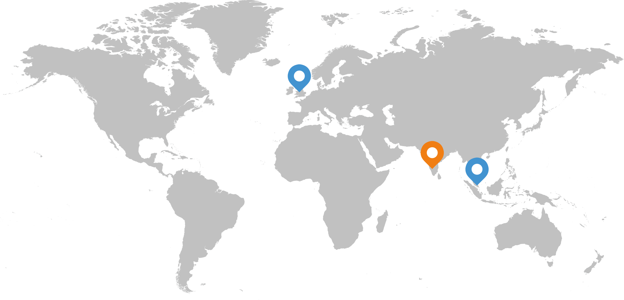
Global Locations
Offices
Development Center

Slide 19
Contact Us

