Slide 2
Company Overview
Fortunesoft provides full-cycle services in the Areas of Enterprise Web, Mobility and Cloud Services
Fortunesoft is a leading Information Technology (IT) Service Company -
Servicing Clients in North America, UK, Europe, Middle East, Singapore and Australia
Development center in Bangalore, India
Fortunesoft provides IT Services and specific solutions to Customers in Various Domains

Slide 3
Our Services

Slide 4
Engagement Models

Slide 5
Time and Material Model

Slide 6
Fixed Scope Fixed Quote & Hire Dedicated Resources

Slide 7
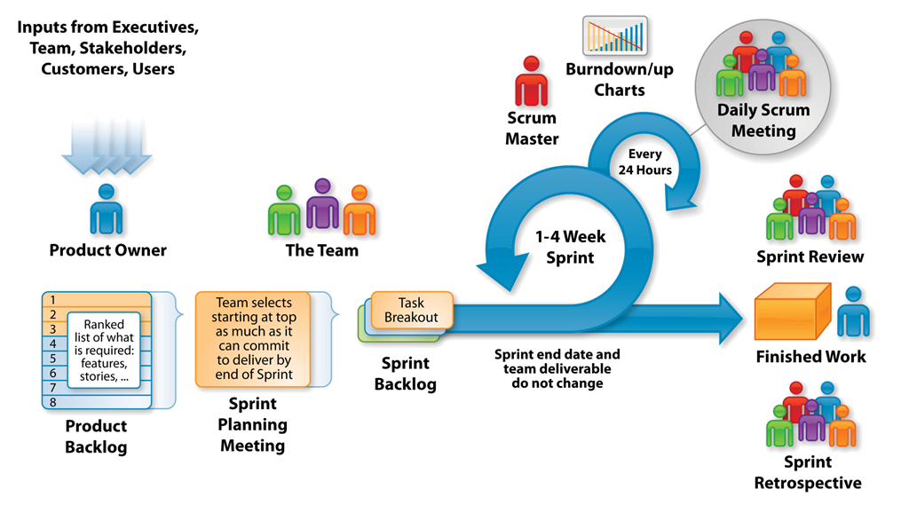
Project Execution: The Agile - Scrum Framework

Slide 8
Task Order - Service Level Agreement
The “Task Order” represents the Service Level Agreement (“SLA” or “Agreement”), is the contract between the two parties – the CONSULTANT (Fortunesoft IT Innovations) and the CLIENT.
The purpose of the Task Order is to provide an insight into the Scope, Cost and Terms & Conditions specific to the project.
The Task Order shall become effective on the date of signature by the CLIENT and the CONSULTANT, and remain in effect until completion of the task on or before the timeframe agreed to by parties.
Modifications or changes to the specific terms of this Task Order shall be made only upon mutual written agreement by the parties.

Slide 9
Task Order - Service Level Agreement
The CLIENT shall own all intellectual property, including technical information, know-how, models, drawings, specifications, prototypes, inventions and source codes developed by the CONSULTANT personnel in performance of the Project (“Intellectual Property”).
Any additional work coming outside the scope of the Task Order during the course of the project will be considered as a change request and will go through the CONSULTANT’s change management process. The CONSULTANT will provide prior intimation to the CLIENT before addressing any such change request(s) that will incur additional cost for the CLIENT.

Slide 10
Task Order - Service Level Agreement
Service Availability
Telephone/Skype support : 9:30 A.M. to 6:30 P.M. IST Monday – Friday
Email support: Monitored 9:30 A.M. to 6:30 P.M. IST Monday – Friday
Calls/Emails received outside of office hours will be collected, however no action can be guaranteed until the next working day.
The CONSULTANT's team will be working for 8 hours a day for five days a week starting from Monday to Friday. The CONSULTANT team will be following the CONSULTANT Company’s working calendar.

Slide 11
Task Order - Service Level Agreement
Service Requests
The CONSULTANT will respond to service related incidents and/or requests submitted by the CLIENT within the following time frames:
0-4 hours (during business hours) for issues classified as Immediate priority/Showstopper .
0-8 hours (during business hours) for issues classified as High priority.
Within 48 hours for issues classified as Medium priority.
Within 5 working days for issues classified as Low priority.

Slide 12
Why Fortunesoft?
Industry experience of more than 9+ years
Specialization in custom design & development
Innovative Team Members with Web 2.0 Expertise
Quality driven delivery service model
Strong Technology Expertise
Save your project cost up to 40%
Full-cycle services in software development
Global performance based project management
Notes:
Domain Expertise
Proven Track record in timely delivery of Small, medium and Large Scale Projects
Implementing Cutting Edge Technology & Business Solutions
Ability to work round the clock depending on the client geography
Innovative Team Members with Web 2.0 Expertise
Quality Driven Service Delivery Model
Operational Efficiency & Flexibility
Global Exposure and Diverse Expertise

Slide 13
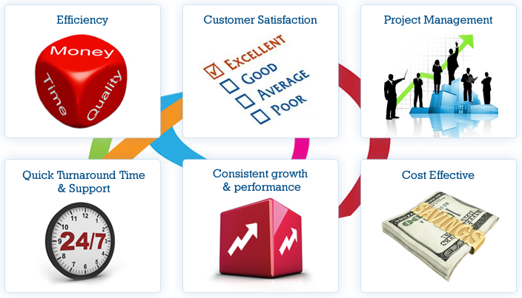
Value Propositions

Slide 14
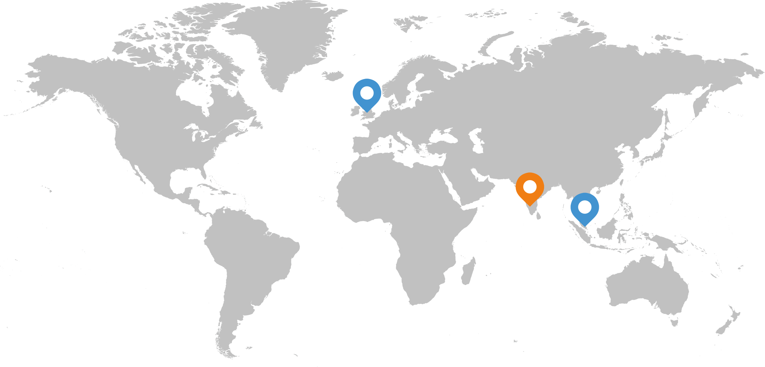
Global Locations
Offices
Development Center

Slide 15
Contact Us

